Slide 1

KICP/AA Workshop
Session 4: Open Discussion and Lunch
12:00 PM -1:00 PM, ERC 576
January 30, 2020
rcc.uchicago.edu

Slide 2
Overview
XSEDE Resources and Campus Champion
KICP liaison
Conclusions

Slide 3
XSEDE Resources and Campus Champion

Slide 4
XSEDE: (www.xsede.org)
Resources:
1. STAMPEDE 2 AND FRONTERRA AT TACC
2. BRIDGES AT PSC
Campus Champion:
1: Raj Shukla at RCC
emailed: rajshukla@uchicago.edu

Slide 5
KICP liaison

Slide 6
Prof. Nickolay Y. Gnedin, KICP UCHICAGO, Fermi Lab

Slide 7
Conclusions

Slide 8
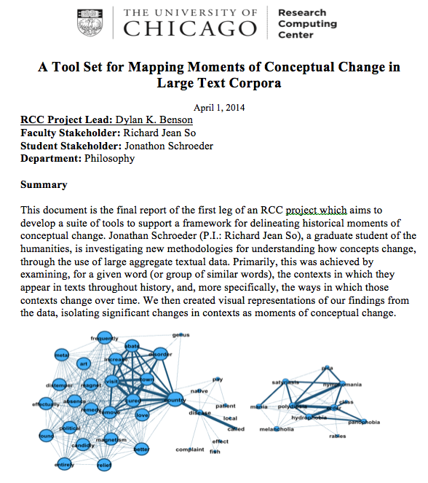
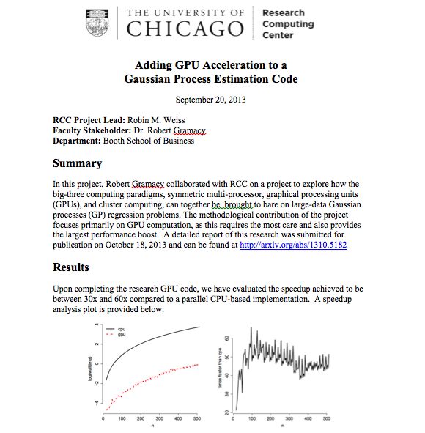
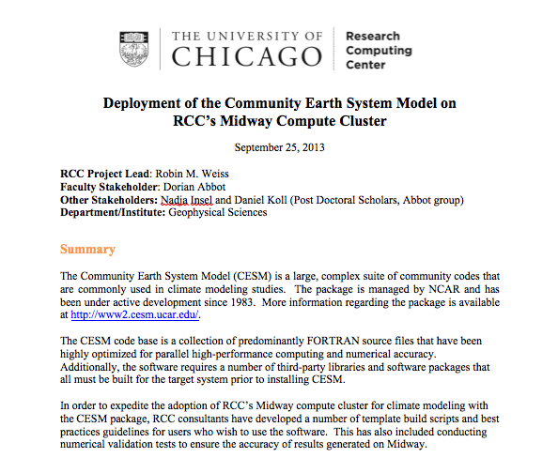
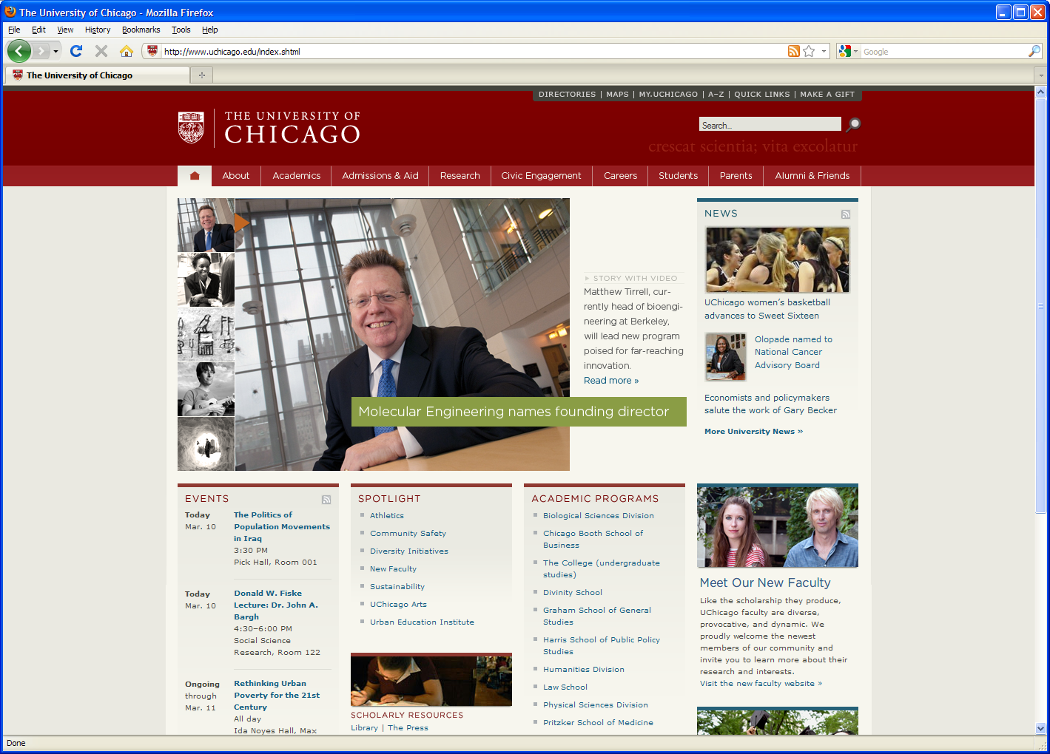
RCC Advanced Technical Support
Parallelization of serial codes
AI – Machine and Deep Learning
Code development and optimization
E.g.: RCC consultants achieved up to 1300 times speed up
Software development
Application software development
Grant support
RCC defines Computational Scientists as RCC staff experienced in both primary research as well as computing and visualization techniques relevant to their field of expertise.

Slide 9
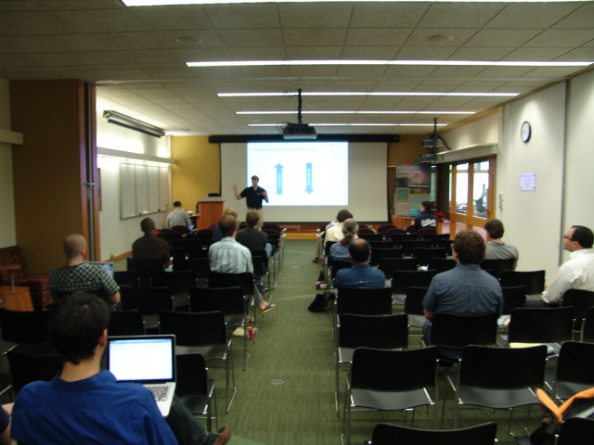
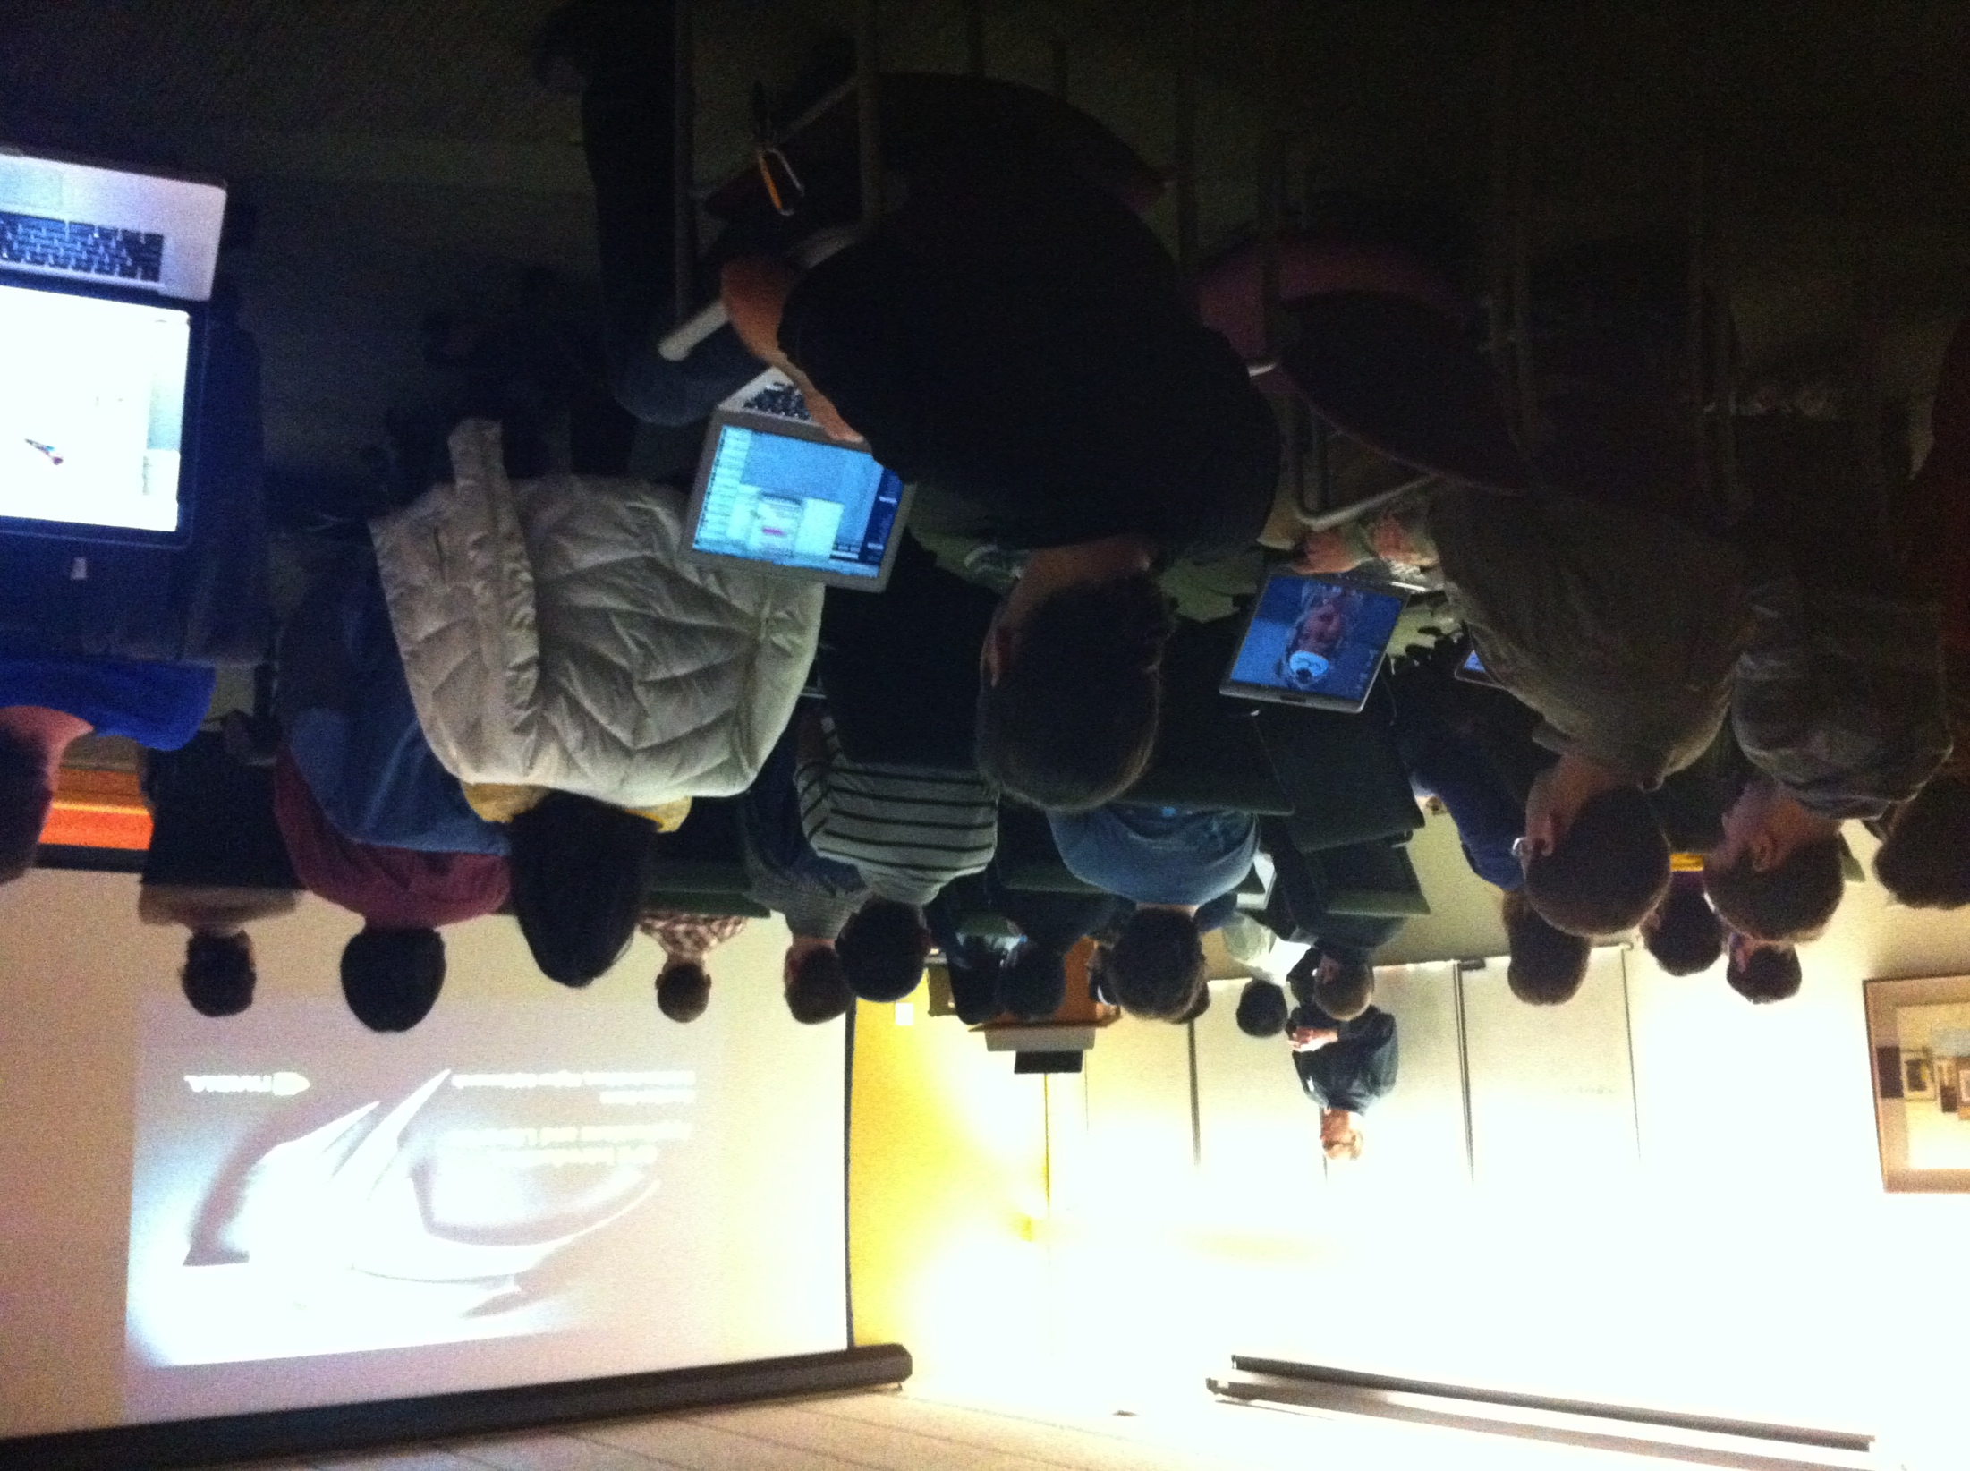
Workshops, Tutorials and Advanced Training
Scheduled throughout the year
Invite software vendors
One on one
Hackathons
Boot camps

Slide 10
Workshops/Tutorials/Seminars
https://rcc.uchicago.edu/support-and-services/workshops-and-training
Spring 2020 Workshops
1/21/20: Introduction to the RCC
1/28/20: Analysis of Genetic Data 1: inferring population structure
2/4/20: Introduction to ArcGIS
2/11/20: Intermediate ArcGIS
02/20/20: Introduction to Computer Vision in Python
02/25/20: Neural Networks for Word Vectors and Word Embeddings in Python
03/10/20: Performance Guidelines of Neural Network Models
03/17/20: Web Scraping and Text Parsing in Python

Slide 11
Conclusion
The RCC offers variety of services including high-end computing to UChicago researchers
The Midway ecosystem includes compute, storage, and software
The MidwayR ecosystem includes compute, storage, and software to process regulated data
Send us an email at help@rcc.uchicago.edu if you have any question

Slide 12
References
The Midway user guide:
https://rcc.uchicago.edu/docs
Two factor authentication:
https://2fa.rcc.uchicago.edu
The Software Carpentry Linux lesson:
http://swcarpentry.github.io/shell-novice/

Slide 13
RCC Help
Contact:
By email: help@rcc.uchicago.edu
Web: rcc.uchicago.edu
Phone: 773-795-2667
In person:
5607 S Drexel Avenue
Regenstein – Room 216
Workshops and Tutorials:
http://rcc.uchicago.edu/services/training.html
A bottom–up approach to supporting research computing

Slide 14
RCC Help
Email: help@rcc.uchicago.edu
Phone: 773-795-2667
Web: rcc.uchicago.edu
In person: Regenstein room 216 or 5607 S Drexel Ave

Slide 15
Questions?

